Slide 1
Artificial Intelligence (Machine Learning & Deep Learning)
{
Measures of Dispersion & Position
}
...

Slide 2
{
..
"Talk is cheap. Show me the code." – Linus Torvalds
(Creator of Linux and Git)
}
..

Slide 3
Contents of Day 8
Data Types & Measures of Central Tendency
Recap & introduction | Moving from Python OOP to Data Science. Why AI needs data.
Core Thoery | Dispersion: Variance & Standard Deviation. Coefficient of Variation (CV). Skewness & Kurtosis. Position: Quartiles & Percentiles. Z-Score
Lab Practice | Practical coding tasks implementing method
Advance Lab | Building the automated Govt Tax Auditing Pipeline.
Wrap-up & Q&A | Debugging tips along with Q&A and suggestion
Important: Use of AI for solving given task is not allowed. Cellphones must be put on silent.

Slide 4
Core Concept (Definition & Rules)
Measures of Dispersion (The Spread) - Variance & Standard Deviation
Definition:
Standard Deviation (SD): A number that describes how spread out the values are.
A low SD means most numbers are close to the mean (average) value.
A high SD means the values are spread out over a wider range.
Variance: Another number that indicates how spread out the values are. In fact, if you take the square root of the variance, you get the standard deviation!
The Govt Analogy: The Highway Authority is auditing traffic speeds. If everyone drives 86 km/h, the Standard Deviation is basically 0 (low risk). If some drive 32 km/h and others drive 138 km/h, the Standard Deviation is huge (high risk of accidents!).

Slide 5
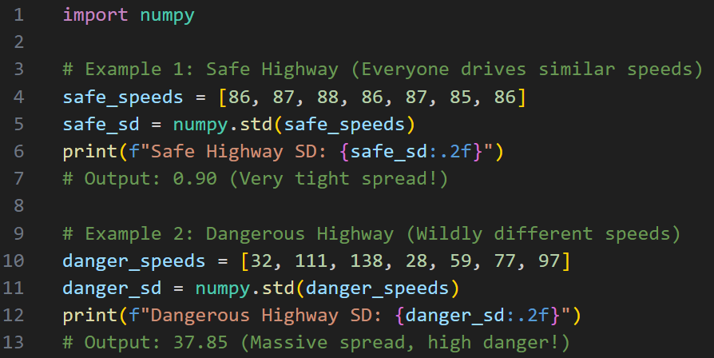
Core Concept (Definition & Rules)

Slide 6
Core Concept (Definition & Rules)
Percentiles & Quartiles
Definition:
Percentiles: A number that describes the value that a given percent of the values are lower than.
Quartiles: A special type of percentile that strictly divides the data into four equal parts (25%, 50%, 75%).
The Govt Analogy: The National Census is looking at the ages of people living on a specific street to plan for a new school. If you find the 75th percentile, you know that 75% of the people on that street are younger than that exact age.

Slide 7
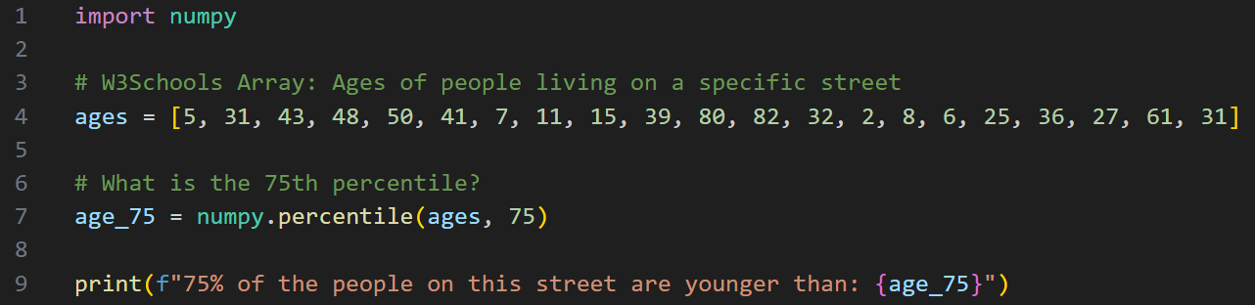
Core Concept (Definition & Rules)
Percentiles & Quartiles

Slide 8
Core Concept (Definition & Rules)
Coefficient of Variation, Skewness & Kurtosis
Definition:
Coefficient of Variation (CV): Standard Deviation divided by the Mean. It gives you a clean percentage so you can compare the spread of two totally different datasets.
Skewness: Tells you if the data is lopsided. Does the tail of the data drag to the left or the right?
Kurtosis: Tells you how "heavy" the tails are. Are there extreme, wild outliers lurking at the edges of your data?
The Govt Analogy: If the National Wealth data has High Kurtosis and Right Skewness, it means the middle class is shrinking and a few extreme billionaires are hoarding the wealth at the far-right edge of the graph.

Slide 9
Core Concept (Definition & Rules)
Definition:
The Z-Score
Z-Score: A numerical measurement that describes a value's relationship to the mean of a group of values, measured in Standard Deviations.
The Govt Analogy: The Tax Authority wants to catch fraudsters. A Z-Score of 0 means your tax return is perfectly average. A Z-Score of +3 means your income is suspiciously high compared to your neighbors. A Z-Score of -3 means you are claiming impossible poverty. Flag them for an audit!

Slide 10
Thank You for Your Focus Today!
What was the most confusing part of today's lab?
Waleed Khan (Robotics Engineer | Senior Python Developer)
Email: 0xcloudcoder@gmail.com Contact: +923126008702
}
*

